Slide 1

A Method to Determine Bubble Size Distribution with
Magnetic Particle Tracking
Jack Halow
Separation Design Group
Waynesburg, PA
Presented at the 2016 NETL Multiphase Workshop
August 9-10, 2016
Morgantown, WV

Slide 2
Objectives
Develop a methed to determine bubble size distribution with Magnetic particle Tracking (MPT)
Acquire data sets to show a “proof of concept”
Apply MPTS to develop statistically significant measures that characterize fluidized solids behavior and bubble size distribution
Acquire data sets that can be used for validation of first principles, two phase, low order and process models.

Slide 3
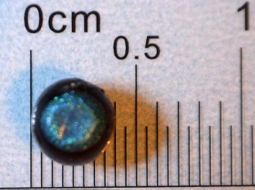
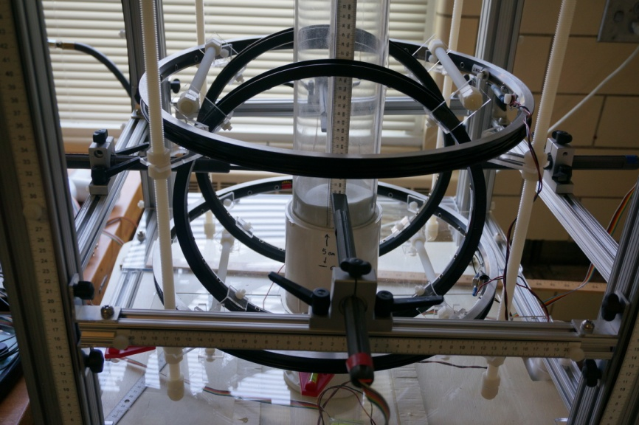
What is MPTS
A method using magnetic tracers and external magnetic field sensors to measure motion in fluid beds
Tracer particles are constructed by inserting a tiny neodymium magnet into a lower density particle
Single tracer particle injected into bed that follows the motion of solids
Magnetic field signals from tracer sampled and recorded
Algorithms de-convolute signals to give 3D trajectory
Trajectory data analyzed to characterize solids motion

Slide 4
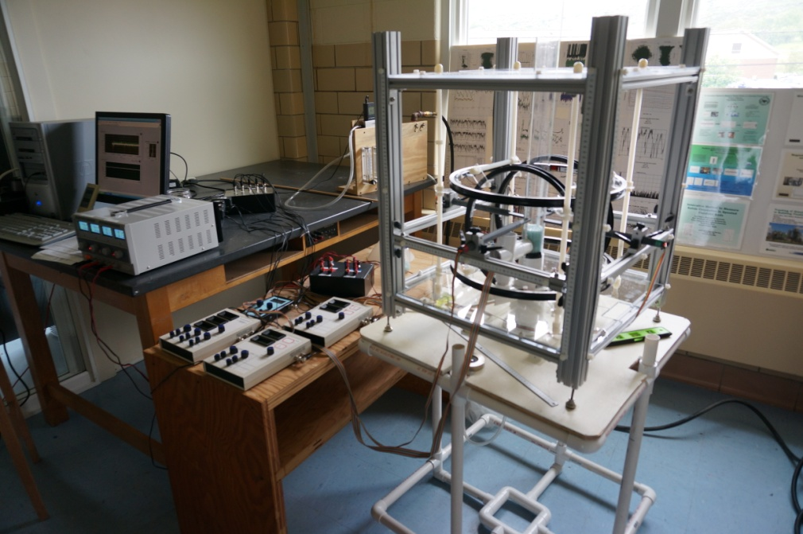
MPTS Key Features
Ridged but adjustable stand to accurately position field sensors
Helmholtz coils to shape and control external magnetic field in the test volume
NI16 bit interface and Lab View Software to acquire and log data
High quality shielding to reduce noise
Algorithms to filter data and further reduce noise
Mass flow meter and multiple valves to accurately control and measure flow

Slide 5
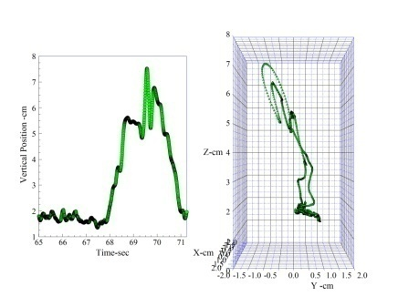
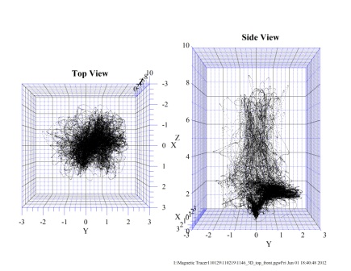
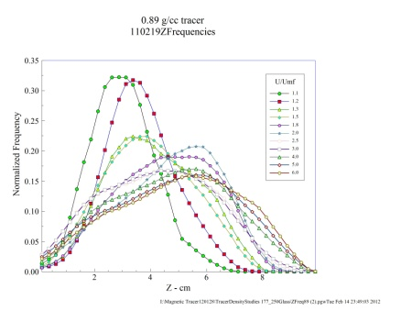
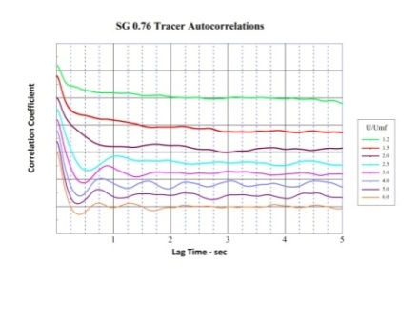
Information we get from MPTS
3D trajectory data
  Visualize tracer motion
    Position versus time graphs
    3D vector plots
    Visualize average position
    “Dot clouds” 3D or 2D slicesa
  Quantitative spatial information
    Frequency distributions i.e. Weibull
    Fit to statistical models
  Quantitative temporal information
    Autocorrelation or FFT
Bubble size distribution
  Overall and versus bed height
  Determine bubble coalescence dynamics

Slide 6
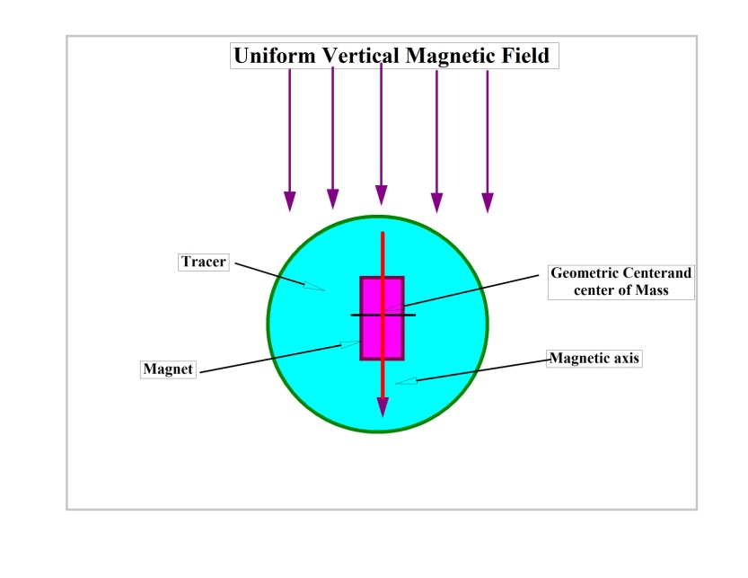
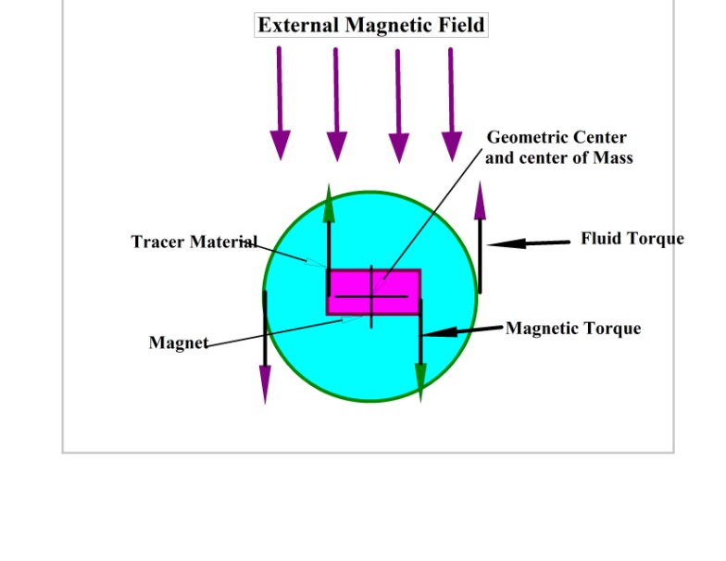
Tracer Rotation Key to Bubble Sizes
Tracer in quiet bed
Tracer orientation has magnetic axis vertical parallel to external field
Bubbles induce shear at the interface with emulsion phase – Other shear events less significant
Tracer Disturbed by bubble
Shear imposes a torque on tracer causing it to rotate
Imposed vertical field from earth’s magnetic field and Helmholtz coils resists this rotation
If tracers center of gravity is not at geometric center, gravity also affects rotation

Slide 7


Torque on the Tracer from Bed Shear
Use Faxen’s Law from Laminar Theory:
  Only Gradient perpendicular to magnetic axis matters and fluid is not rotating. So:

Slide 8
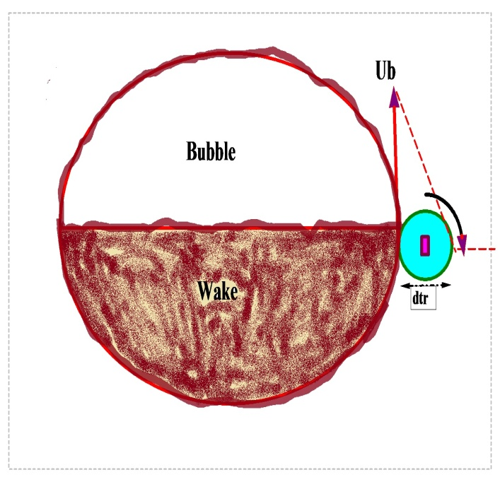

What is Gradient and Viscosity?
Velocity gradient:
Viscosity (Grace 1970):

Slide 9

Magnetic torque
Interaction of magnet with external magnetic field:
Maximum torque at 90 degrees

Slide 10


Torque Balance
Or
Where

Slide 11



Bubble Velocity
Using V=0.71(gD_{b})^{1/2} to eliminate D_{b}
Velocity is relative to tracer, need to subtract U-U_{mf}

Slide 12
All Parameters are Known
Θ= frontal angle of bubble at 200 to 240°
Lmg = length of magnet
p = magnet field strength at pole surface
|H| = external magnetic field strength
ρ_{p} = particle density
ε_{mf} =void fraction at minimum fluidization
d_{tra} = tracer diameter
U_{s} = superficial velocity
U_{mf} = minimum fluidization velocity

Slide 13
Gravitational Torque
If magnet is not centered in tracer, the offset center of mass will produce a torque
Gravitational torque
contribution can
be calculated, but small
size makes this difficult
Better approach is to
determine in fluid bed
by finding external field
that offsets gravity and
lets tracer to freely rotate

Slide 14
Experiments
5.5 cm bed with porous plate distributor
Settled bed depth of 11 cm (H/D=2)
Glass beads
  107-177 micron
  177-250 micron
U_{s} up to 2U_{mf}
300 sec runs
External field varied from 0 to 6x earth field
Determine number of <90 degree rotations or events (to match force balance) in run

Slide 15
Rotations Vary with External Field

Slide 16
Results for 107-177 Glass Beads

Slide 17
Results for 177-250 Glass Beads

Slide 18
Bubble Frequency
d(Events)/dDb is a constant
Probability on an event require tracer encounter a bubble with tracer is (x-area of bubble/x-area of bed)
Number of bubbles in bed= d(Events)/dDb / (D_{bub} /D_{bed} )²
Bubble Frequency ~1/(D_{bub})²

Slide 19
Conclusions
Preliminary evaluation appears promising for determining bubble size statistics from MPT measurements
An indirect measurement (like exoplanet detection from star brightness variability)
Vector nature of magnetic field has potential to measure more bed properties like shear and turbulence
What’s next? …Make measurements in single orifice bed with controlled known bubble size
One instrument does both solids motions and bubble size distributions

Slide 20
Publications
E. Patterson, J. Halow, and S. Daw, “Innovative Method Using Magnetic Particle Tracking to Measure Solids Circulation in a Spouted Fluidized Bed,” Ind. Eng. Chem. Res. 2010, 49, 5037–5043.
J. Halow, K Holsopple, B. Crawshaw, S. Daw, C. Finney, “Observed Mixing Behavior of Single Particles in a Bubbling Fluidized Bed of Higher-Density Particles,” Ind. Eng. Chem. Res., 2012, 51, 14566-14576.
C.S. Daw, J. Halow, “A Random Walk Model for Biomass Particle Mixing in Bubbling Fluidized Beds,” Ind. Eng. Chem. Res., 2014
J. Halow, An Update on Magnetic Particle Tracking, NETL Multiphase workshop, August, 2015, Morgantown, WV

Slide 22
Background
Understanding solids motion in multiphase systems is neede for many processes
Various methods have been used -- 2-D beds, tracer methods (radioactive, fluorescent, color, temperature, etc) and tomographic methods, in bed probes
Passive magnetic tracking is non-invasive, safe, inexpensive and easy to use
All methods have drawbacks and limitations

Slide 23
MTPS Current Capabilities
Beds up to 10 cm in diameter have been studied (larger sizes possible)
Sampling rates up to 200 hertz
Runs times to 10 minutes
Sensitivity <0.1 milligauss →equivalent to ~30 cm with smallest tracers
Temperatures to 200-300 Centigrade possible
Can be applied to spouting, bubbling, circulating fluid beds, granular flow or liquid flow systems
Tracer sizes > ~ 2 mm and densities > 0.4 g/cc
Trade offs can be made with tracer size, bed size, bed properties to extend range of experiements

Slide 24
Why linear correlations?
Actual bubble size number distributions are not linear
Event occurs when a bubble encounters a tracer so
Probability on an encounter of any bubble with tracer is (x-area of bubble/x-area of bed)
Or (D_{bub} /D_{bed} )²
Number of bubbles = Events x (D_{bub} /D_{bed} )²
Number distribution is 1/ (D_{bub})³

